Slide 1

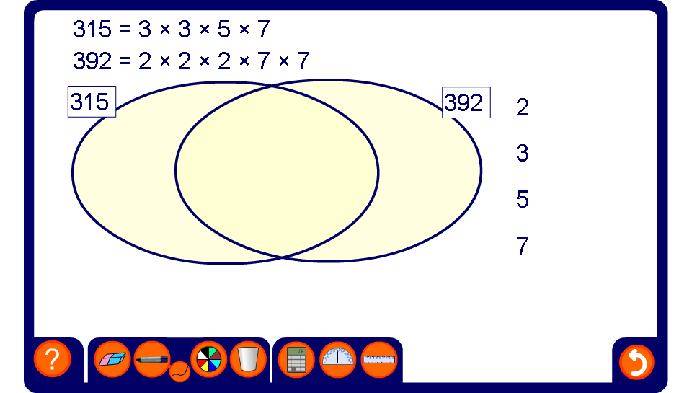


Using prime factors to find the HCF and LCM

